Slide 1




One Size Does Not Fit All:
An Empirical Study of Containerized Continuous Deployment Workflows
Yang Zhang, Bogdan Vasilescu, Huaimin Wang, Vladimir Filkov
November 24, 2018

Slide 2

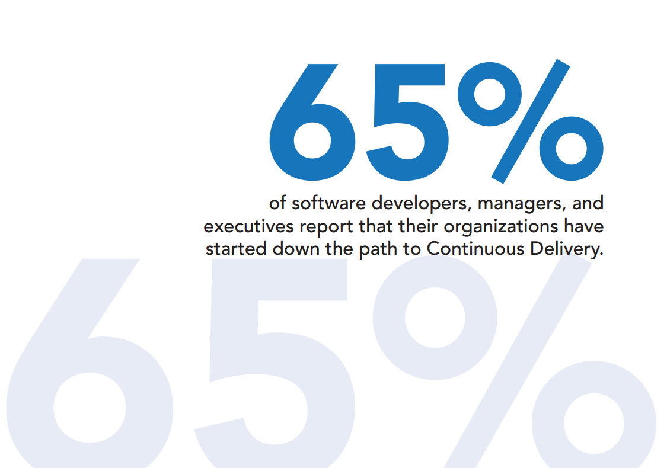
Continuous Delivery/Deployment
It is a software engineering approach in which software functionalities are delivered frequently through automated deployments.
It is the ability to release software whenever we want…it could mean every check-in goes straight to production…it is the ability to deploy at will.
“On the journey to continuous deployment: Technical and social challenges along the way". Information and Software Technology. 2015.
“Continuous delivery? easy! just change everything (well, maybe it is not that easy)”. AGILE. 2013.
https://www.perforce.com/sites/default/files/files/2017-09/continuous-delivery-report.pdf
Notes:
Give a definition of CD
Show that CD is widely used

Slide 3

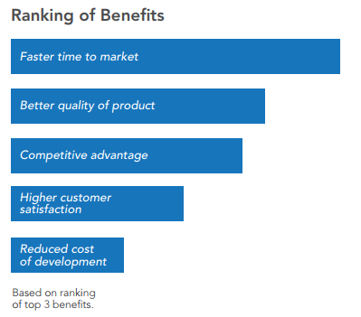

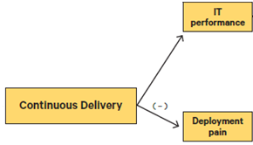
Notable Benefits
https://puppet.com/resources/whitepaper/2017-state-of-devops-report
https://www.perforce.com/sites/default/files/files/2017-09/continuous-delivery-report.pdf
Notes:
From two reports, show that CD is beneficial

Slide 4

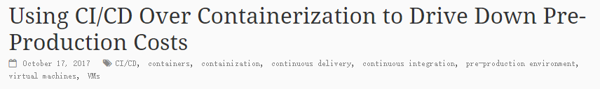
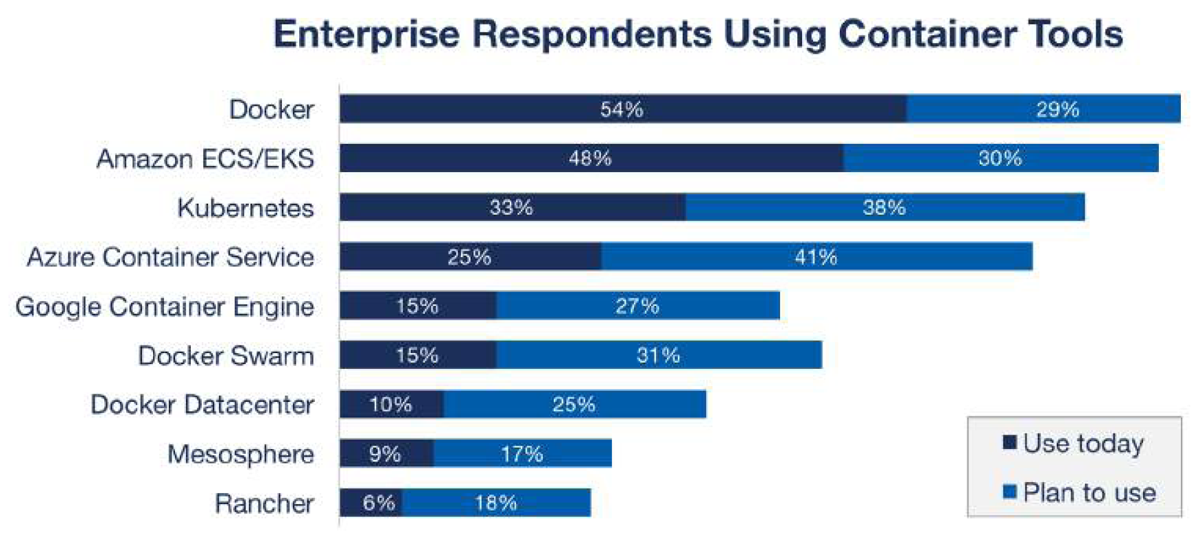

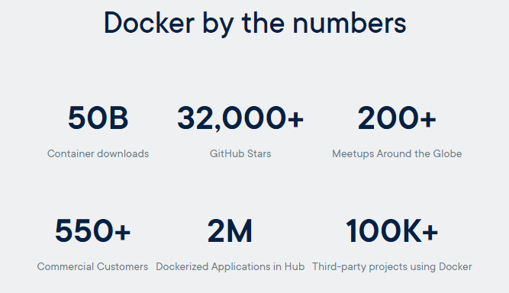
Containerization & Docker
Faster time to market
Optimum use of infrastructure
One-click infrastructure provisioning and decommissioning
docker
https://containerjournal.com/2017/10/17/using-cicd-containerization-drive-pre-production-costs/
https://www.suse.com/media/report/rightscale_2018_state_of_the_cloud_report.pdf
Notes:
Show that containerization brings benefits to CD
Docker has become the de-facto industry standard of containerization

Slide 5

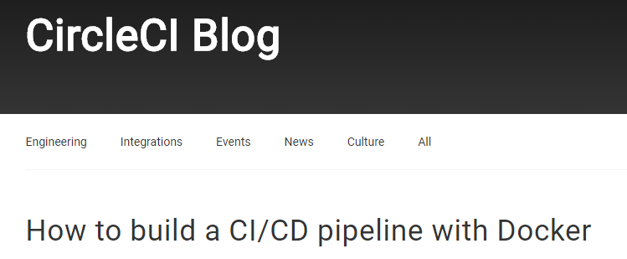

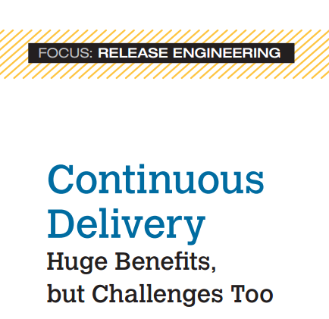
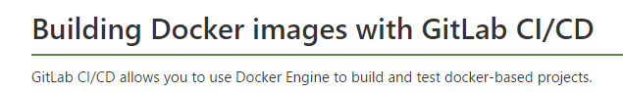

Containerized CD Workflow/Pipeline
“The truth is, that containers really make some things easier and more manageable but you still have to use them properly. One area where containers can really make a difference is the automated deployment pipeline.”
“Research is needed to identify these processes (covering areas of business, software development, operations, and so on) and develop and verify alternatives that suit CD.”
Continuous Delivery Huge Benefits, but Challenges Too. IEEE Software. 2015.
https://ghost.kontena.io/container-deployment-pipeline/
https://circleci.com/blog/build-cicd-piplines-using-docker/
https://sloppy.io/en/blog/automatic-docker-deployment-with-travis-ci-and-sloppy-io/
https://docs.gitlab.com/ee/ci/docker/using_docker_build.html
https://blog.docker.com/2016/04/cicd-with-docker-cloud/
Notes:
Some studies pointed out that CD pipeline is important
Many practical tools and solutions have been provided for developers

Slide 6




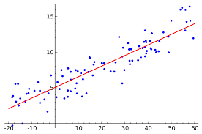
Our Work: How OSS Projects Use Docker-enabled CD Workflows on GitHub
GitHub
Docker Hub
Workflows? Unmet needs? Barriers?
Differential benefits?
https://blog.advaoptical.com/en/many-roads-to-400g-in-the-data-center
Notes:
Our RQs

Slide 7



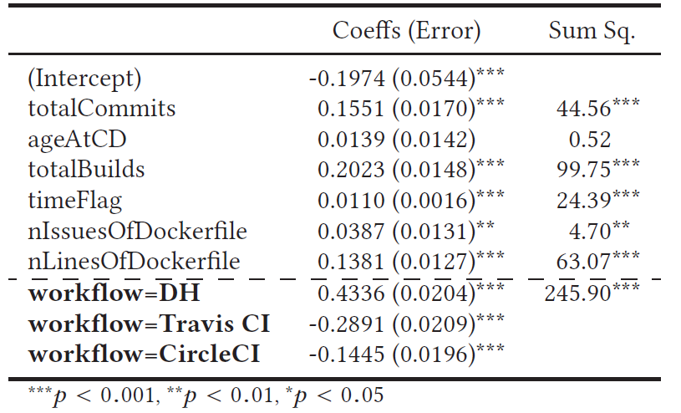
Approach: Mixed-methods
Hypotheses
Regression modeling
Notes:
Our approach

Slide 8



Developer survey
1,000 invitations, 168 responses
Which workflow do developers use in their CD pipeline?
What are the unmet needs in the current CD workflows?
Did developers switch their CD workflows? Why?
Notes:
Give an overview of our survey questions

Slide 9

Two most prominent CD workflows
34.5%
44.1%
CI-based Workflow
(CIW)
Docker Hub auto-builds Workflow
(DHW)
Notes:
We found two CD workflows…although there are many other workflows, these two are the most prominent.

Slide 10





Unmet needs for current workflow
(89.9% of respondents are satisfied)
Quicker build speed and higher throughput
“One dockerfile takes more than 2 hours to build and timeouts”
21.7%
Easier to learn and config.
“Sometimes, circle CI config and setup is pain. Docs sometimes doesn’t help”
16.9%
21.3%
Does release frequency tend
to decrease over time ?
Experienced increasing processing latency over time
Does image build latency tend to increase over time ?
Notes:
We give two reasons to indicate developers’ unmet needs
Based on the survey answers, we also distill two questions (hypotheses)

Slide 11


Barriers with old CD workflow
(45.8% of respondents changed)
Difficult to setup and maintain
“The old CD pipeline is a little harder to setup. It was necessary to write several scripts to get everything working properly. The new CD pipeline is easier to setup and maintain”
35.2%
Weak support for automation
“Our old workflow contained many manual steps prone to errors, while with the new workflow everything goes smoothly”
18.3%
Notes:
We give two barriers

Slide 12



Building Hypotheses from Survey
DHW
CIW
Does CIW have longer build latency than DHW ?
Does CIW have higher release frequency than DHW ?
Notes:
We talk about the complexity of two workflows
Their differences in support of docker and automated testing
We give two questions (hypotheses)

Slide 13




Our hypotheses
H1. Release frequency tends
to decrease over time.
H2. Build latency tends to increase over time.
H3. Configuration stability tends to increase over time.
H4. CIW tends to have more failed builds than DHW.
H5. CIW tends to have longer build latency than DHW.
H6. CIW tends to have higher release frequency than DHW.
H7. CIW tends to have lower configuration stability than DHW.
H8. Within CIWs, CI tools should not be different.
H1+H6
H4
H3+H7
H2+H5
Release frequency
Build results
Configuration stability
Build latency
Notes:
Overview of our hypotheses
Their relationship with the next regression models

Slide 14
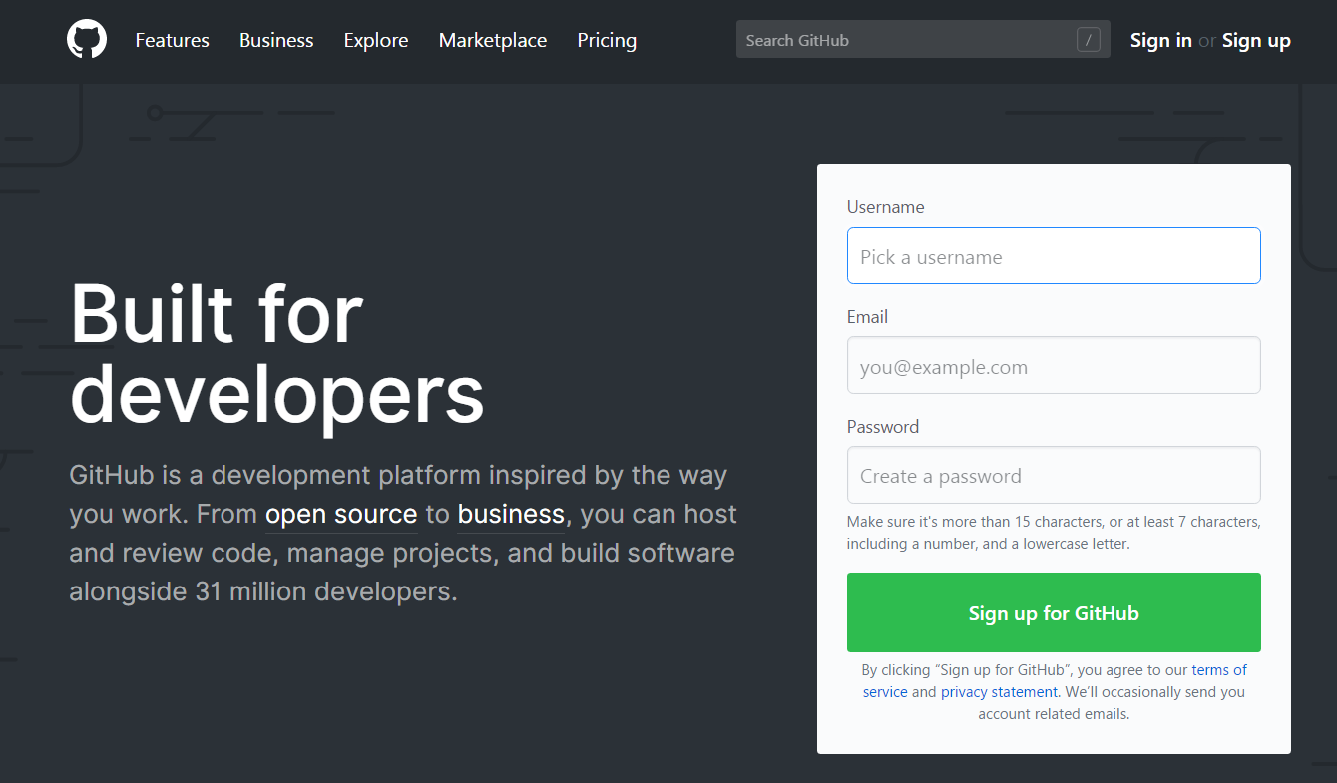
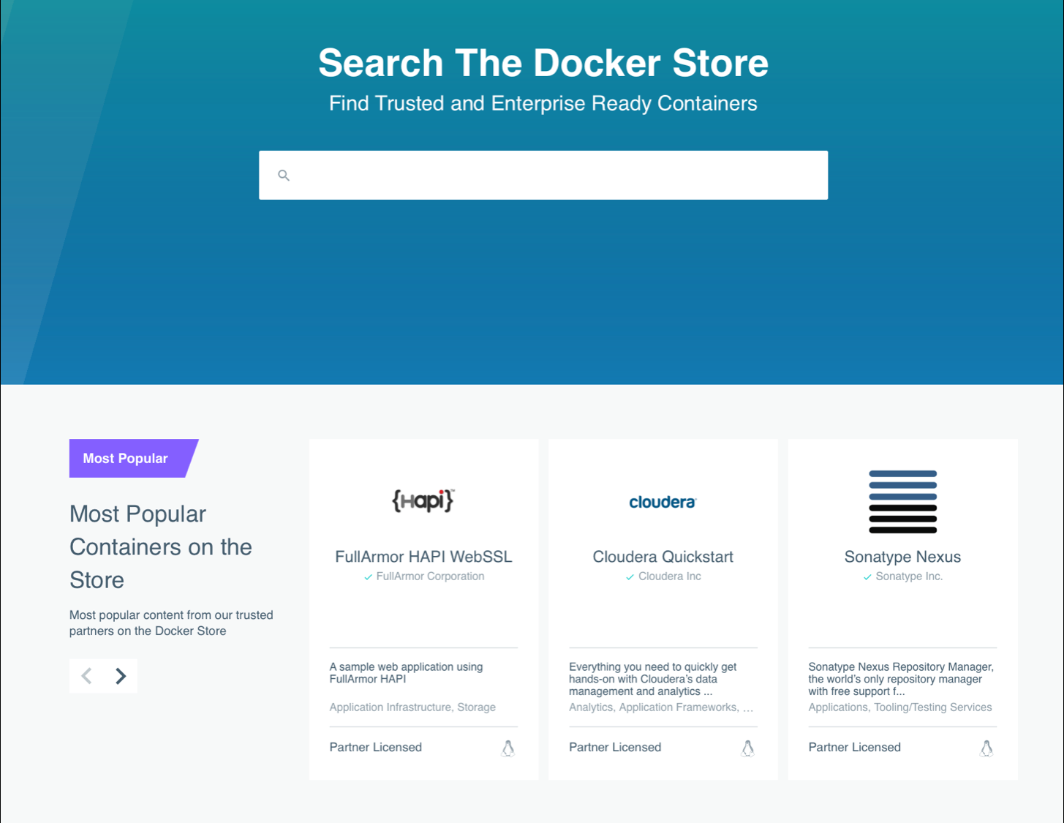










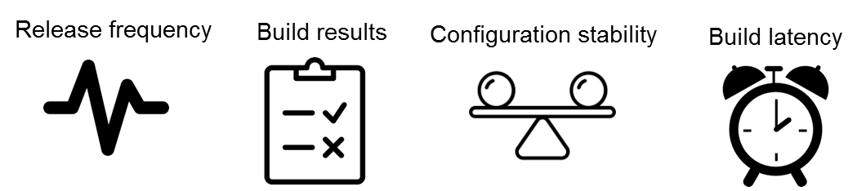
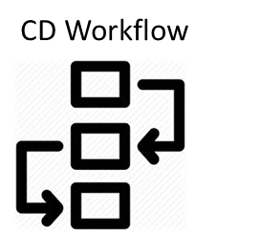
Testing Hypotheses via a Large-scale quantitative study
428 DH projects
236 Circle CI projects
191 Travis CI projects
+
39,094 Docker Hub builds
30,990 Travis CI builds
63,509 Circle CI builds
~
Notes:
The main process we did the large-scale quantitative study

Slide 15









Mixed-effects regression models
Response
#SuccessBuilds
#ErrorBuilds
#DockerfileChanges
avg.BuildLatency
CD Workflow
Independent
Time
Control
#Builds
#Commits
+
CD Age
…
Base Image
Notes:
Response, independent, and control

Slide 16




Release frequency & CD workflow
Time
—
Release frequency
DHW
—
+
+
CD Workflow
Travis CIW
（#SuccessBuilds/month)
Circle CIW
H1. Release frequency tends
to decrease over time.
H6. CIW tends to have higher release frequency than DHW.
Notes:
Two findings

Slide 17
Build latency & CD workflows
Time
+
Build latency
DHW
+
—
Travis CIW
—
（avg.BuildLatency/month)
CD Workflow
Circle CIW
H2. Build latency tends to increase over time.
H5. CIW tends to have longer build latency than DHW.
Notes:
Two findings

Slide 18

Trade-Offs between CD workflows
DHW
CIW
Higher simplicity
Higher configurability
Diverse needs
Higher performance
Lower maintenance
Higher reliability
Lower experience
Higher scalability
Notes:
From our study, we find that when doing cd, developers face …

Slide 19
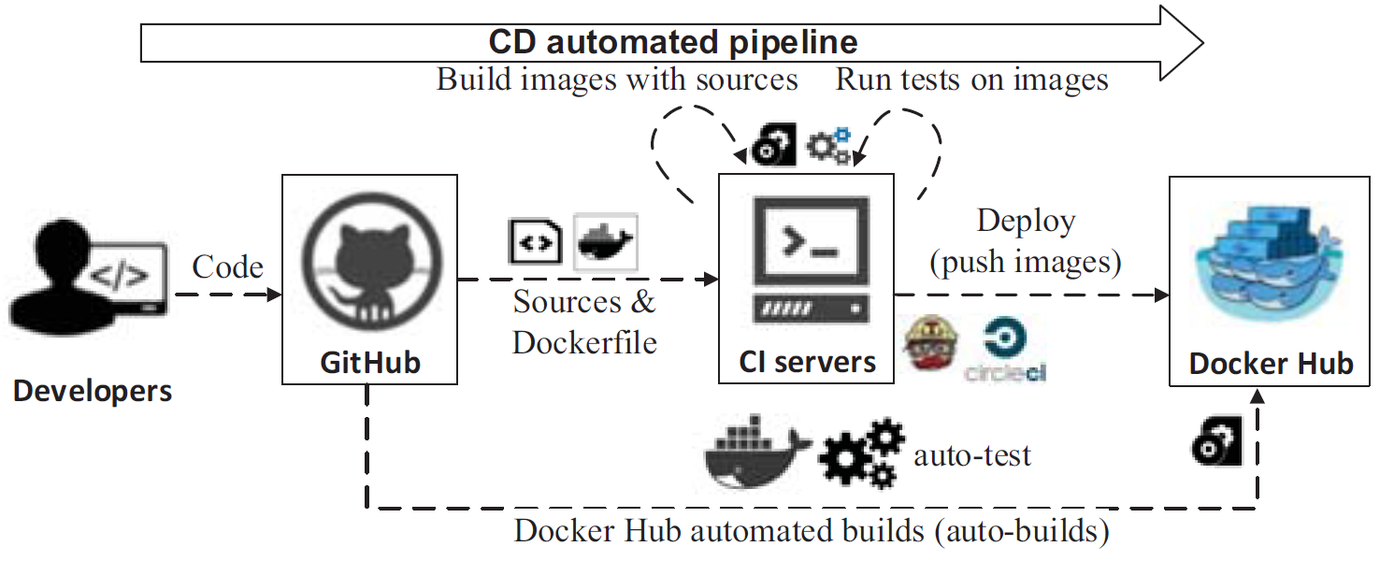
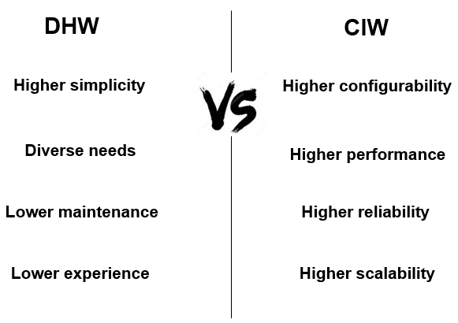
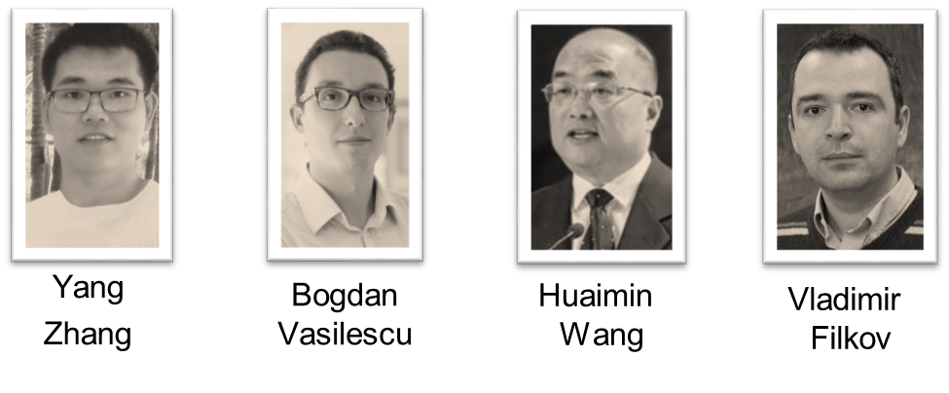


One Size Does Not Fit All:
An Empirical Study of Containerized Continuous Deployment Workflows
Two CD workflows: DHW and CIW;
Unmet needs and barriers;
Developers face
trade-offs between DHW and CIW
Notes:
。。。

Slide 20

BibTeX
@inproceedings{Zhang2018cd,
author = {Zhang, Yang and Vasilescu, Bogdan and Wang, Huaimin and Filkov, Vladimir},
title = {One Size Does Not Fit All: An Empirical Study of Containerized Continuous Deployment Workflows},
booktitle = {Proceedings of the 2018 26th ACM Joint Meeting on European Software Engineering Conference and Symposium on the Foundations of Software Engineering},
series = {ESEC/FSE 2018},
year = {2018},
pages = {295--306},
url = {http://doi.acm.org/10.1145/3236024.3236033},
publisher = {ACM}
}
https://yangzhangs.github.io/
yangzhang15@nudt.edu.cn

